Slide 1

Essential Rhapsody in C++
Section 3
Intermediate Level
Int-<number>
The Rhapsody in C++ Tool Training "Essential" © I-Logix 1999-2000 v2.3 25/9/2000

Slide 2
Section 3: Intermediate
Full power of statecharts
Simple 1 to 1 relations
Composite classes
Inheritance
Virtual Operations
Model checking
Documentation
…
Int-<number>
The Rhapsody in C++ Tool Training "Essential" © I-Logix 1999-2000 v2.3 25/9/2000

Slide 3
Intermediate
In this section we will start to build more complicated models
In the first example, we will see how to build more powerful statecharts
Then we will start to look at connecting classes together with relations
Int-<number>
The Rhapsody in C++ Tool Training "Essential" © I-Logix 1999-2000 v2.3 25/9/2000

Slide 4
Section 3
Intermediate
Dishwasher
Int-<number>
The Rhapsody in C++ Tool Training "Essential" © I-Logix 1999-2000 v2.3 25/9/2000

Slide 5
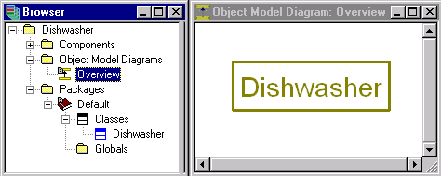
Dishwasher
Create a new project called Dishwasher in C:\Rhapsody\Work\Dishwasher
Create a new Object Model Diagram Overview
Draw a single class Dishwasher
Int-<number>
The Rhapsody in C++ Tool Training "Essential" © I-Logix 1999-2000 v2.3 25/9/2000

Slide 6
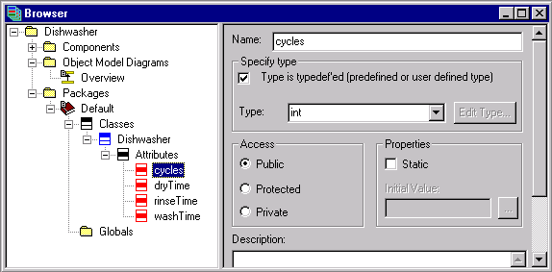
Adding Attributes
Add the following attributes all of type int
  rinseTime, washTime, dryTime & cycles
Int-<number>
The Rhapsody in C++ Tool Training "Essential" © I-Logix 1999-2000 v2.3 25/9/2000

Slide 7
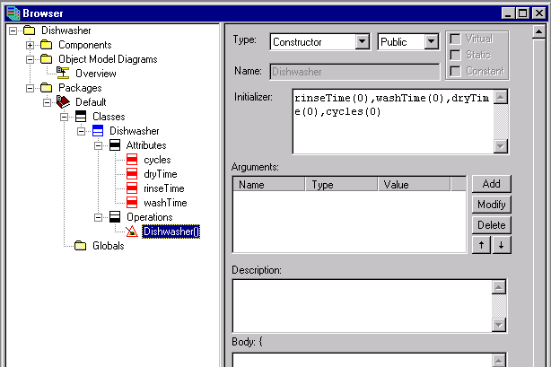
Adding a Constructor
Add a Constructor
Initialize attributes in Constructor initializer
  rinseTime(0),washTime(0),dryTime(0),cycles(0)
Int-<number>
The Rhapsody in C++ Tool Training "Essential" © I-Logix 1999-2000 v2.3 25/9/2000

Slide 8


Adding Operations
OMBoolean isDried()
  return ( dryTime == 0 );
OMBoolean isRinsed()
  return ( rinseTime == 0 );
OMBoolean isWashed()
  return ( washTime == 0 );
Int-<number>
The Rhapsody in C++ Tool Training "Essential" © I-Logix 1999-2000 v2.3 25/9/2000

Slide 9
Adding More Operations
Add a setup routine with body :
add a routine isInNeedOfService that returns an OMBoolean with body
  rinseTime=4;
  washTime=5;
  dryTime=3;
  cycles++;
  return (cycles>2);
Int-<number>
The Rhapsody in C++ Tool Training "Essential" © I-Logix 1999-2000 v2.3 25/9/2000

Slide 10
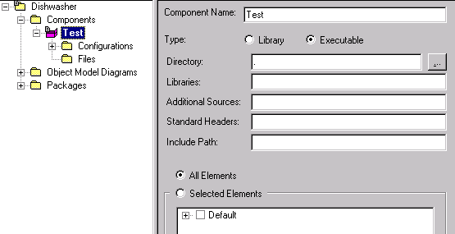
Creating a Test Component
As before rename the DefaultComponent to Test
Int-<number>
The Rhapsody in C++ Tool Training "Essential" © I-Logix 1999-2000 v2.3 25/9/2000

Slide 11
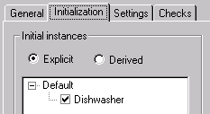
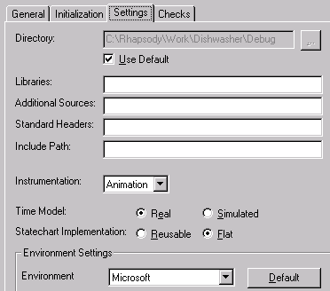

Creating a Debug configuration
Rename the DefaultConfig configuration to Debug
Set Instrumentation to Animation
Create initial instance of the Dishwasher class
Int-<number>
The Rhapsody in C++ Tool Training "Essential" © I-Logix 1999-2000 v2.3 25/9/2000

Slide 12

Save / Generate / Make
Before adding a statechart, check by generating code and doing a make, that there are no errors.
We are now going to add a statechart to our Dishwasher that will use the operations that we have just created.
In this version of Rhapsody there is no undo ( coming very soon ) so when building the following statechart don’t forget to save occasionally.
Int-<number>
The Rhapsody in C++ Tool Training "Essential" © I-Logix 1999-2000 v2.3 25/9/2000

Slide 13
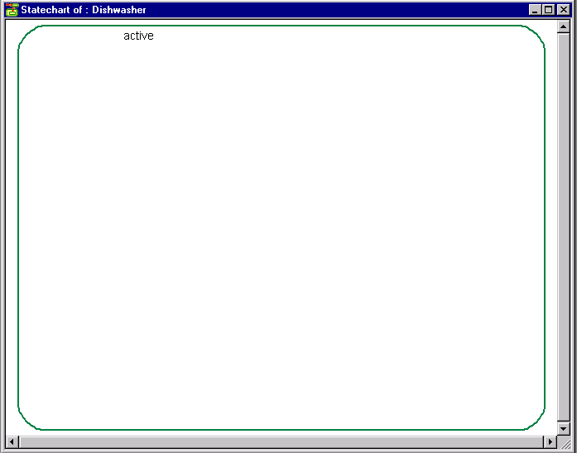
Creating a Statechart
Open a new statechart and draw a state as large as possible and name active.
Int-<number>
The Rhapsody in C++ Tool Training "Essential" © I-Logix 1999-2000 v2.3 25/9/2000

Slide 14
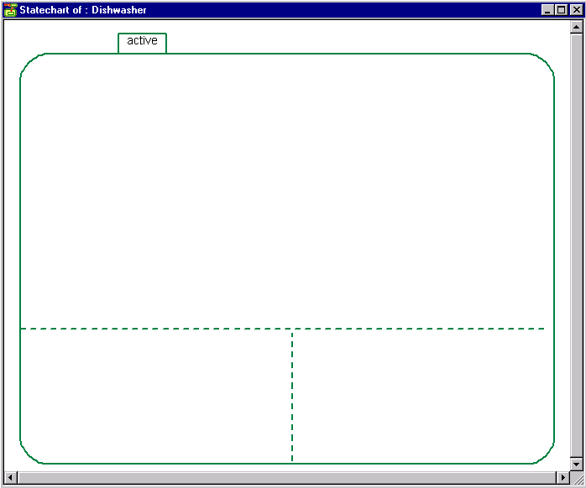
Creating Concurrent States
Use the and-line icon to create concurrent states
This box with “active”
inside will appear when
the and lines are drawn
Draw this line first
Concurrent states
Note the only way to move an AND-line, is to delete it and redraw it.
Int-<number>
The Rhapsody in C++ Tool Training "Essential" © I-Logix 1999-2000 v2.3 25/9/2000

Slide 15
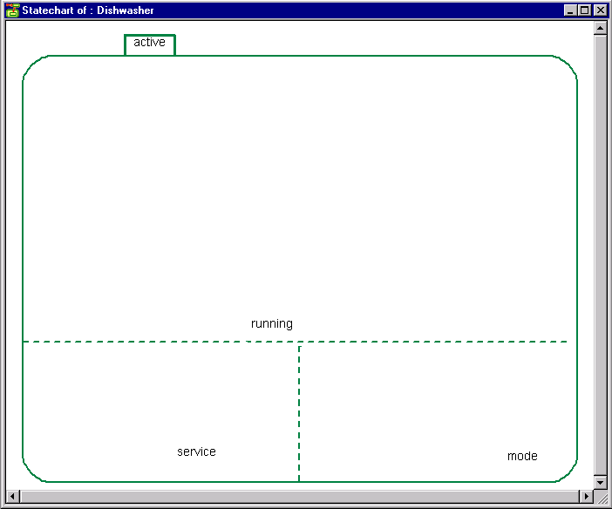
Naming the Concurrent States
Name the concurrent states using the icon; running, service and mode.
Int-<number>
The Rhapsody in C++ Tool Training "Essential" © I-Logix 1999-2000 v2.3 25/9/2000

Slide 16
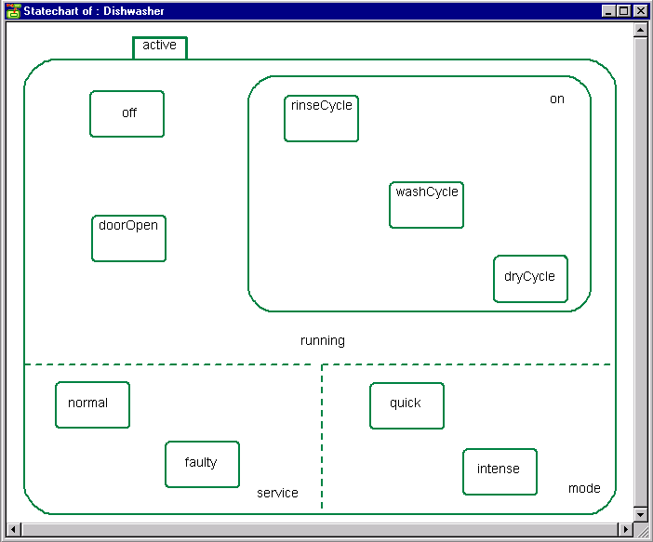
Adding States
Add the following states .
Int-<number>
The Rhapsody in C++ Tool Training "Essential" © I-Logix 1999-2000 v2.3 25/9/2000

Slide 17
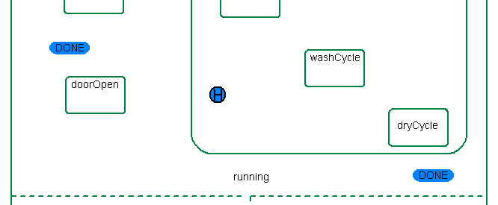
Adding History and Diagram Connectors
Add a history connector to the on state.
Add two identical diagram connectors named done using the icon.
Int-<number>
The Rhapsody in C++ Tool Training "Essential" © I-Logix 1999-2000 v2.3 25/9/2000

Slide 18
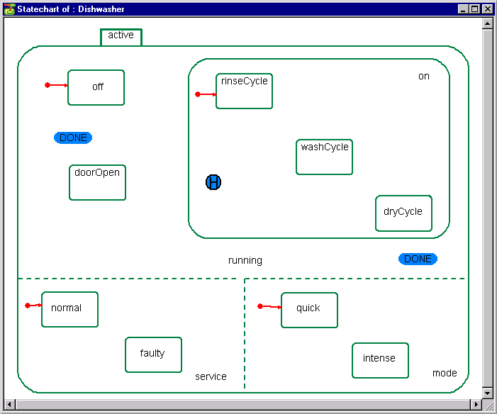
Adding Default Transitions
Add the following four default transitions :
Int-<number>
The Rhapsody in C++ Tool Training "Essential" © I-Logix 1999-2000 v2.3 25/9/2000

Slide 19
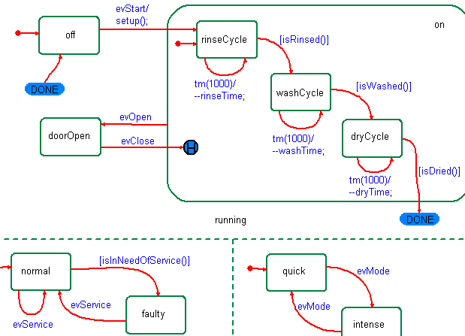
Adding the Transitions
Add the following transitions :
Int-<number>
The Rhapsody in C++ Tool Training "Essential" © I-Logix 1999-2000 v2.3 25/9/2000

Slide 20
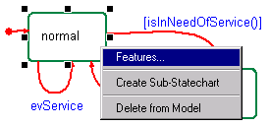
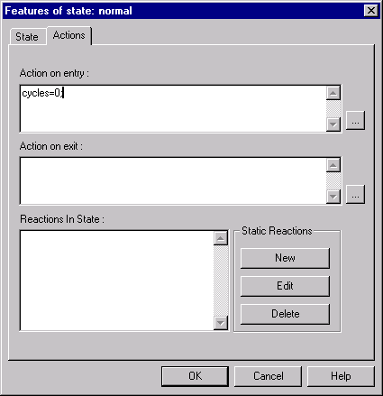
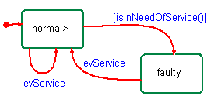
Completing the Statechart
In the normal state, bring up the features and
  set as entry action cycles=0;
Note that setting an action in a state causes a > sign to appear.
Int-<number>
The Rhapsody in C++ Tool Training "Essential" © I-Logix 1999-2000 v2.3 25/9/2000

Slide 21
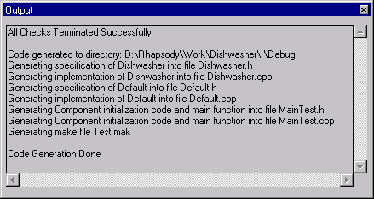
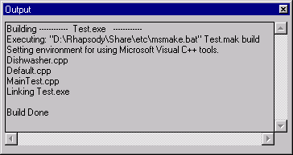
Save / Generate / Make / Run
Save the model then Generate/Make/Run
Int-<number>
The Rhapsody in C++ Tool Training "Essential" © I-Logix 1999-2000 v2.3 25/9/2000

Slide 22
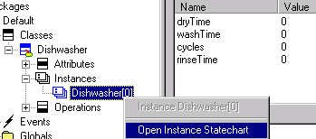
Starting the Animation
Do Go Idle to create instance.
In browser check the attributes are all initialized.
Right click on the Dishwasher instance to Open Instance Statechart.
If there is no instance created, then it is probable that an initial instance of Dishwasher was not selected in the configuration.
Int-<number>
The Rhapsody in C++ Tool Training "Essential" © I-Logix 1999-2000 v2.3 25/9/2000

Slide 23
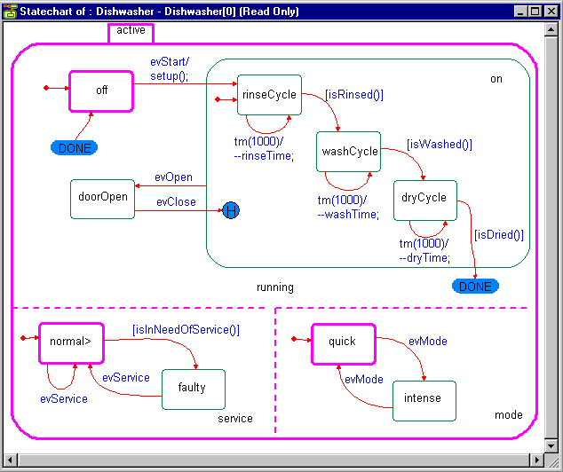
Animated Statechart
Check there are three animated states
✰


Int-<number>
The Rhapsody in C++ Tool Training "Essential" © I-Logix 1999-2000 v2.3 25/9/2000

Slide 24
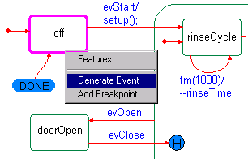


Animating the Statechart
Inject an event evStart into the model by right-clicking in the animated statechart and selecting Generate Event
Select event evStart
The event will appear in the “Event Queue”
Events can also be generated via the Command prompt or via the Event Generator
Int-<number>
The Rhapsody in C++ Tool Training "Essential" © I-Logix 1999-2000 v2.3 25/9/2000

Slide 25
Debugging at the Design Level
Do go idle or go and watch the animation.
Does your Dishwasher work properly ?
What happens if the door opens then closes, does it remember the previous state ?
Does after the third cycle, the service state change from normal to faulty ?
Can you get the Dishwasher back to the normal state ?
Int-<number>
The Rhapsody in C++ Tool Training "Essential" © I-Logix 1999-2000 v2.3 25/9/2000

Slide 26
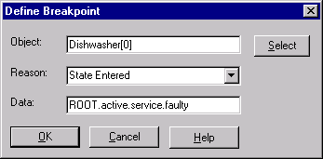
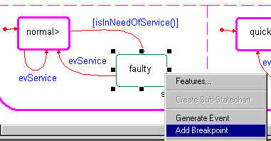
Setting Breakpoints
Setting breakpoints can be done in a similar way to injecting events.
Breakpoints can be added/removed via the breakpoint icon.
Int-<number>
The Rhapsody in C++ Tool Training "Essential" © I-Logix 1999-2000 v2.3 25/9/2000

Slide 27
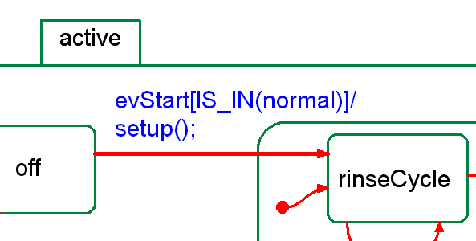
Extended Exercise
Modify the Statechart so that when in the state faulty the Dishwasher will not start.
IS_IN is a macro that tests to see if the object is in a particular state.
Int-<number>
The Rhapsody in C++ Tool Training "Essential" © I-Logix 1999-2000 v2.3 25/9/2000

Slide 28

The Command Prompt
Events and breakpoints can also be generated through the command prompt .
For example an event evStart can be injected by typing “Dishwasher[0]->GEN(evStart)” in the command window.
GEN is a macro that will create ( using new ) the event before sending it to the object.
Int-<number>
The Rhapsody in C++ Tool Training "Essential" © I-Logix 1999-2000 v2.3 25/9/2000

Slide 29
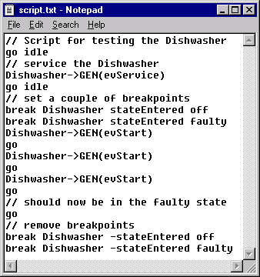

Creating and Running a Script
In the Dishwasher directory, create a text file script.txt that contains the following commands:
Run the script by using the command prompt
Type input script.txt
Int-<number>
The Rhapsody in C++ Tool Training "Essential" © I-Logix 1999-2000 v2.3 25/9/2000

Slide 30
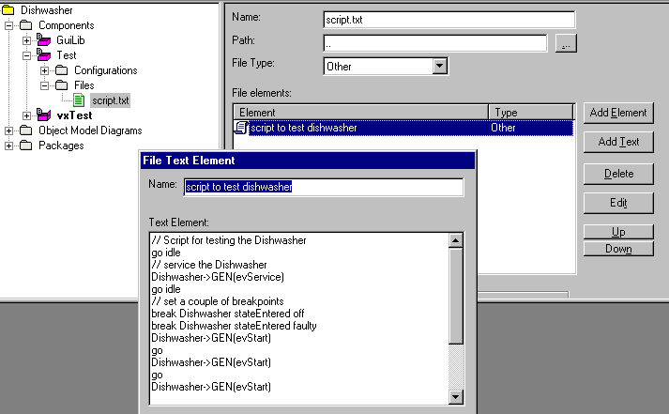
Creating the Script Within Rhapsody
The script can also be created within Rhapsody by creating a file ex: “script.txt” of type “Other” and path “..”.
Int-<number>
The Rhapsody in C++ Tool Training "Essential" © I-Logix 1999-2000 v2.3 25/9/2000

Slide 31
Script
The script in now contained within the model and will automatically be generated whenever the code is generated.
If the script is called “OMAnimator.cfg” then on starting the animation, the script will be automatically run.
Int-<number>
The Rhapsody in C++ Tool Training "Essential" © I-Logix 1999-2000 v2.3 25/9/2000

Slide 32
Section 3
Intermediate
Motor and sensor
Int-<number>
The Rhapsody in C++ Tool Training "Essential" © I-Logix 1999-2000 v2.3 25/9/2000

Slide 33
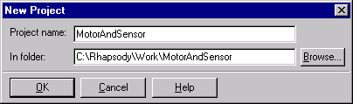
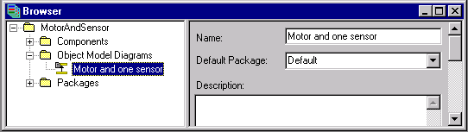
Motor and Sensor
Create a new project “Motor and Sensor”
Open a new OMD called “Motor and one sensor”
Int-<number>
The Rhapsody in C++ Tool Training "Essential" © I-Logix 1999-2000 v2.3 25/9/2000

Slide 34
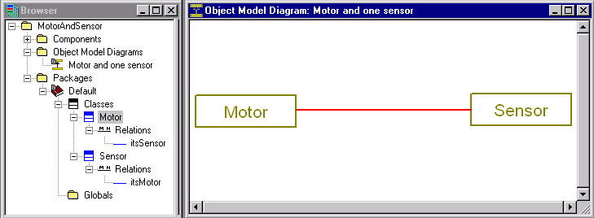
Creating a Relation
Draw two classes Motor & Sensor
Connect them with an association
Note that if you use the delete key to delete erroneous relations, you only remove them from the view and in fact they remain in the model.
Int-<number>
The Rhapsody in C++ Tool Training "Essential" © I-Logix 1999-2000 v2.3 25/9/2000

Slide 35
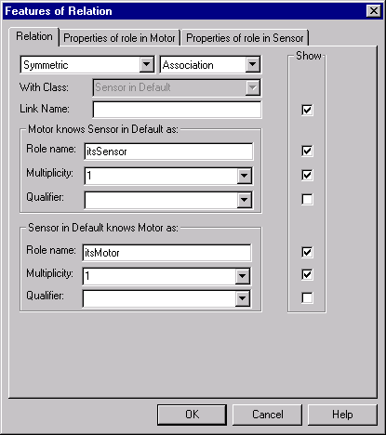
Setting the Multiplicity
Double-click or right-click on the association to edit the features
Accept default role names itsMotor & itsSensor
Tick the Show boxes to display the role names
Set multiplicity of the association to 1 to 1
Int-<number>
The Rhapsody in C++ Tool Training "Essential" © I-Logix 1999-2000 v2.3 25/9/2000

Slide 36
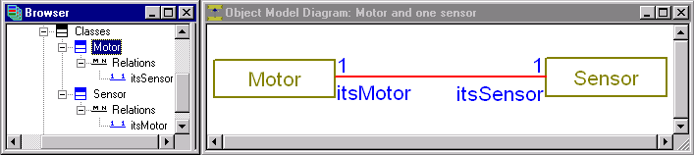
Adding Relations
When adding relations, it is useful to have the browser visible and shrunk with the relations expanded.
An Object Model Diagram does not have to show all the possible relations, it is just a view of the model. The browser however shows every relation.
Int-<number>
The Rhapsody in C++ Tool Training "Essential" © I-Logix 1999-2000 v2.3 25/9/2000

Slide 37
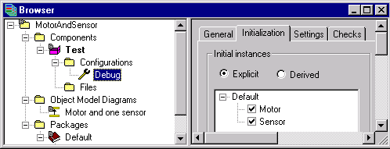
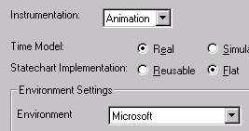
Creating a Configuration
Create a Test component and a Debug configuration that creates initial instances of both the Motor and Sensor classes.
Set instrumentation to Animation
Int-<number>
The Rhapsody in C++ Tool Training "Essential" © I-Logix 1999-2000 v2.3 25/9/2000

Slide 38
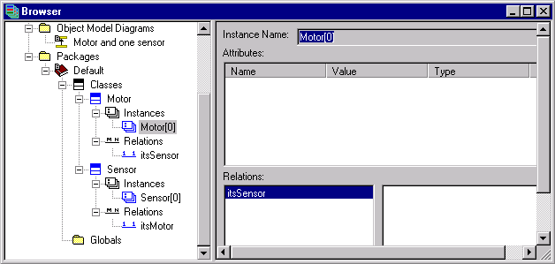
Animating
Save / Generate / Make / Run
Use the browser to see that the relation is not initialized.
NULL
Int-<number>
The Rhapsody in C++ Tool Training "Essential" © I-Logix 1999-2000 v2.3 25/9/2000

Slide 39
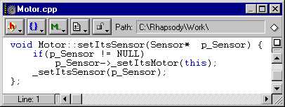
Inspecting the Code
Examine the code for the Motor and note the setItsSensor() routine
This routine will initialize the relation for us
Int-<number>
The Rhapsody in C++ Tool Training "Essential" © I-Logix 1999-2000 v2.3 25/9/2000

Slide 40
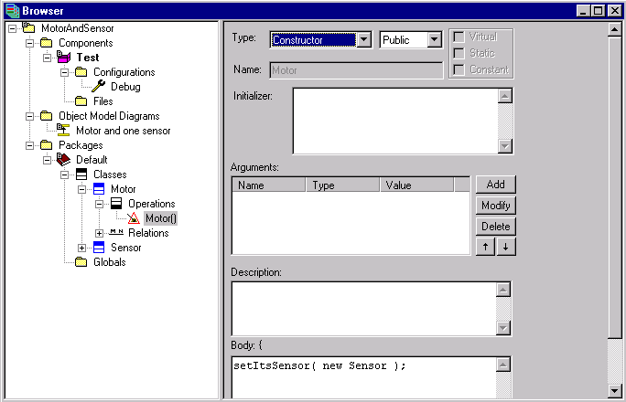
Initializing Relations
Add a constructor for the Motor class and let it create and initialize the Sensor as follows:
  setItsSensor( new Sensor );
Int-<number>
The Rhapsody in C++ Tool Training "Essential" © I-Logix 1999-2000 v2.3 25/9/2000

Slide 41
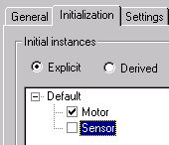
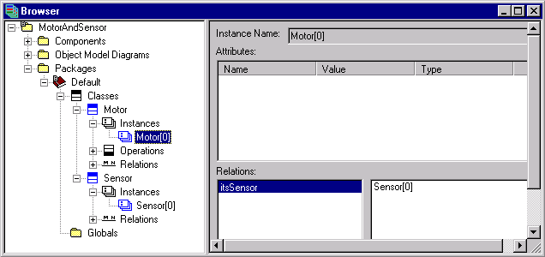
Initialized Relations
Modify the configuration to just create an initial instance of Motor
Save / Generate / Make / Run
Check that the relations are initialized
Int-<number>
The Rhapsody in C++ Tool Training "Essential" © I-Logix 1999-2000 v2.3 25/9/2000

Slide 42
Relations
If you have more than one Sensor, then you have forgotten to remove the initial Sensor from the configuration.
You will notice that Rhapsody generates many operations for a relation. Complete control over these operations can be controlled through the properties for the relation.
The order of creating instances of Motor and Sensor is not evident which is why this more predictable method has been used.
Int-<number>
The Rhapsody in C++ Tool Training "Essential" © I-Logix 1999-2000 v2.3 25/9/2000

Slide 43
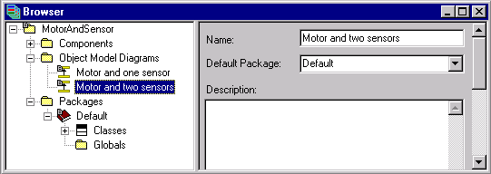
Another View of the Same Class
Create a new Object Model Diagram (OMD)
Rename it “Motor and two sensors”
Either draw a Motor class
Or just drag from the browser
Int-<number>
The Rhapsody in C++ Tool Training "Essential" © I-Logix 1999-2000 v2.3 25/9/2000

Slide 44
Multiplicity, Name and Direction
Add two new classes :
  PressureSensor
  TemperatureSensor
Add an aggregation from Motor to PressureSensor, with multiplicity 1, called itsPressureSensor.
Add a directed association from Motor to TemperatureSensor, with multiplicity 1, called itsTemperatureSensor.
Int-<number>
The Rhapsody in C++ Tool Training "Essential" © I-Logix 1999-2000 v2.3 25/9/2000

Slide 45
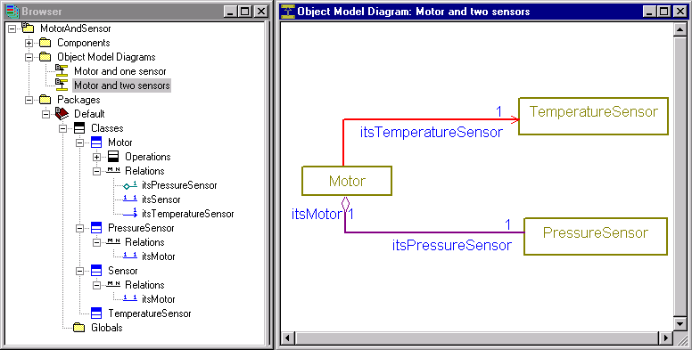
Associations
Directed association
aggregation
Note that we do not have to show all the relations on a single class diagram. Often two or more diagrams are more appropriate.
Int-<number>
The Rhapsody in C++ Tool Training "Essential" © I-Logix 1999-2000 v2.3 25/9/2000

Slide 46
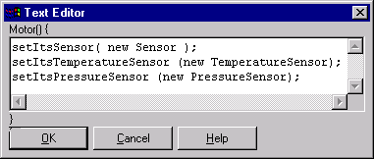
Initializing Associations
In the Motor constructor add:
  setItsTemperatureSensor (new TemperatureSensor);
  setItsPressureSensor (new PressureSensor);
Save / Generate / Make / Run
Int-<number>
The Rhapsody in C++ Tool Training "Essential" © I-Logix 1999-2000 v2.3 25/9/2000

Slide 47
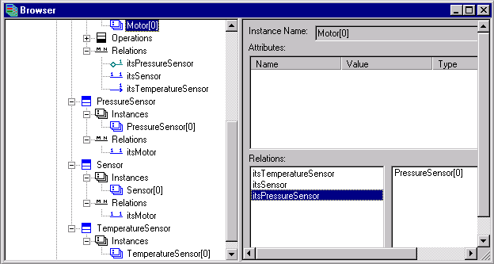
Checking Relations are Initialized
Check that there are instances of all three types of sensor and that all the instances are initialized
Click on each relation to
check initialized
Int-<number>
The Rhapsody in C++ Tool Training "Essential" © I-Logix 1999-2000 v2.3 25/9/2000

Slide 48
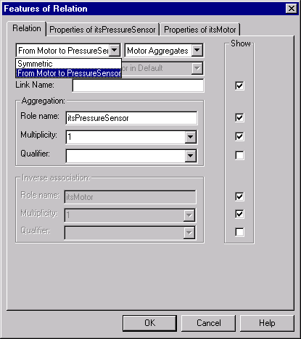
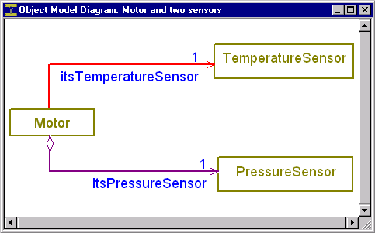
Extended Exercise
Change the aggregation to a directed aggregation.
Int-<number>
The Rhapsody in C++ Tool Training "Essential" © I-Logix 1999-2000 v2.3 25/9/2000

Slide 49
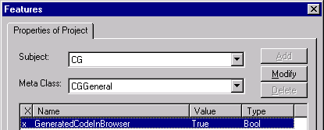
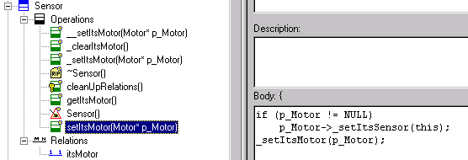
Showing Operations
The operations that Rhapsody generates can be displayed in the browser and overridden.
To do so, set the property CG->CGGeneral->GeneratedCodeInBrowser to True and generate code.
Int-<number>
The Rhapsody in C++ Tool Training "Essential" © I-Logix 1999-2000 v2.3 25/9/2000

Slide 50
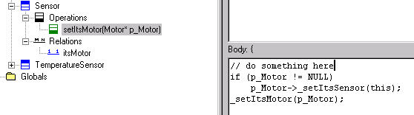
Overriding Operations
Note the symbol for an operation that is automatically generated by Rhapsody.
If this operation is modified, then the symbol reverts to and the modified operation will now override the Rhapsody generated operation.
modification
Note that doing so could affect the animation.
Int-<number>
The Rhapsody in C++ Tool Training "Essential" © I-Logix 1999-2000 v2.3 25/9/2000

Slide 51
Section 3
Intermediate
Composite Motor
Int-<number>
The Rhapsody in C++ Tool Training "Essential" © I-Logix 1999-2000 v2.3 25/9/2000

Slide 52
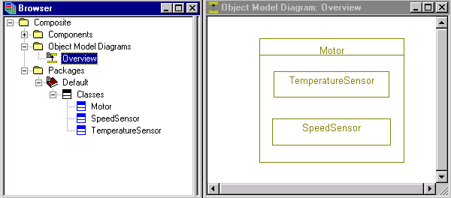
Composite Class
Create a new project “Composite” in C:\Work\Rhapsody\Composite
Create an OMD called “Overview”
Draw a composite class called Motor
Inside the Motor class draw a TemperatureSensor and a SpeedSensor class
Int-<number>
The Rhapsody in C++ Tool Training "Essential" © I-Logix 1999-2000 v2.3 25/9/2000

Slide 53
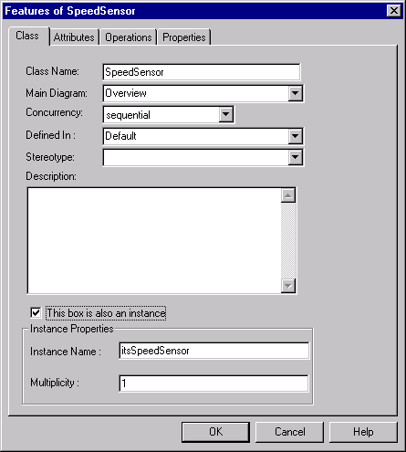

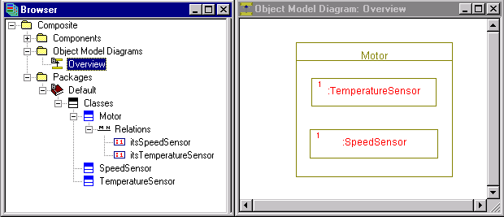
Composite Class
For both classes bring up the features and select “This box is also an instance” .
In each, create an instance of multiplicity 1.
Int-<number>
The Rhapsody in C++ Tool Training "Essential" © I-Logix 1999-2000 v2.3 25/9/2000

Slide 54

Composite Class
Create a component Test and a configuration Debug that creates an initial instance of Motor
Save / Generate / Make / Run
Show that in the browser, one instance of TemperatureSensor and one instance of SpeedSensor have been created.
Examine the code for Motor
Int-<number>
The Rhapsody in C++ Tool Training "Essential" © I-Logix 1999-2000 v2.3 25/9/2000

Slide 55
A Composite in a Composite
Create a new composite class “Dishwasher”
Draw two simple classes called Motor and Heater inside the Dishwasher composite.
Draw a 1 to 1 association between them
In each, create an instance of multiplicity 1.
Int-<number>
The Rhapsody in C++ Tool Training "Essential" © I-Logix 1999-2000 v2.3 25/9/2000

Slide 56


A Composite in a Composite
Modify the configuration to create just an initial instance of the Dishwasher
Save / Generate / Make / Run
By default for a class xyz, a relation will be called itsXyz. Rhapsody will add its and change the first letter to upper case.
Int-<number>
The Rhapsody in C++ Tool Training "Essential" © I-Logix 1999-2000 v2.3 25/9/2000

Slide 57
Instance Names
Note the instance names of objects inside composites:
  Dishwasher[0]->itsMotor->itsSpeedSensor
  Dishwasher[0]->itsHeater
Note that the relation between the Heater and the Motor has been created and initialized.
Examine the generated code.
All associations inside a composite such as between the Dishwasher and the Motor, are directed associations. This can be made symmetric through the browser.
Int-<number>
The Rhapsody in C++ Tool Training "Essential" © I-Logix 1999-2000 v2.3 25/9/2000

Slide 58
Extended Exercise
Modify the number of instances of the Heater inside the Dishwasher to 2.
Change the multiplicity of the relation so that the Motor knows about 2 Heaters.
Save / Generate / Make / Run
See what happens
Examine code
Int-<number>
The Rhapsody in C++ Tool Training "Essential" © I-Logix 1999-2000 v2.3 25/9/2000

Slide 59
Section 3
Intermediate
Inherited Sensor
Int-<number>
The Rhapsody in C++ Tool Training "Essential" © I-Logix 1999-2000 v2.3 25/9/2000

Slide 60

Inherited Sensor
Create a new project called “Inheritance” in C:\Rhapsody\Work\Inheritance
Draw two classes Motor and Sensor
Draw two classes TemperatureSensor and PressureSensor
Int-<number>
The Rhapsody in C++ Tool Training "Essential" © I-Logix 1999-2000 v2.3 25/9/2000

Slide 61

Inheritance
Make the PressureSensor and TemperatureSensor inherit from the base class Sensor.
Add directed associations from the Motor to the PressureSensor and to the TemperatureSensor.
Set the multiplicity to 1.
Int-<number>
The Rhapsody in C++ Tool Training "Essential" © I-Logix 1999-2000 v2.3 25/9/2000

Slide 62



Base Class Sensor
Add attribute name of type OMString
Add a constructor that receives an argument aName of type OMString
Initialize the attribute in the initializer name(aName)
Create an operation print with implementation cout << name << “ “;
Int-<number>
The Rhapsody in C++ Tool Training "Essential" © I-Logix 1999-2000 v2.3 25/9/2000

Slide 63


Motor Class
Create a constructor that creates instances of both types of Sensor:
setItsTemperatureSensor(new TemperatureSensor(“T1”));
setItsPressureSensor(new PressureSensor(“P1”));
Int-<number>
The Rhapsody in C++ Tool Training "Essential" © I-Logix 1999-2000 v2.3 25/9/2000

Slide 64

Derived Sensor Classes
For both derived Sensor classes:
Create a constructor that has an argument aName of type OMString
Set the Initializer to Sensor(aName)
Sensor(aName) invokes the Sensor constructor so as to initialize the name field of the base class.
Int-<number>
The Rhapsody in C++ Tool Training "Essential" © I-Logix 1999-2000 v2.3 25/9/2000

Slide 65

Animating
Create a Test component and a Debug configuration that creates an initial instance of the Motor class
Save / Generate / Make / Run
With the browser, note that there are two instances of Sensor. Each Sensor has a name that has been initialized.
Int-<number>
The Rhapsody in C++ Tool Training "Essential" © I-Logix 1999-2000 v2.3 25/9/2000

Slide 66
Section 3
Intermediate
Virtual Operations
Int-<number>
The Rhapsody in C++ Tool Training "Essential" © I-Logix 1999-2000 v2.3 25/9/2000

Slide 67

Virtual Operations
Save the “Inheritance” project as new project “Virtual” in C:\Rhapsody\Work\Virtual
Add a directed association, multiplicity 1 from the Motor to the Sensor
Create a virtual operation read() in the base class Sensor
Make an operation virtual by checking the virtual box in the features.
Int-<number>
The Rhapsody in C++ Tool Training "Essential" © I-Logix 1999-2000 v2.3 25/9/2000

Slide 68
Overloaded Operations
In the TemperatureSensor add an operation read() with implementation:
cout << “Temperature = “ << rand() % 100 << “deg F” << endl;
In the PressureSensor add an operation read() with implementation :
cout << “Pressure = “ << rand() % 10 << “bars” << endl;
A quick way of creating these read operations is to hold the control key down and drag the read operation from the Sensor class to the TemperatureSensor. This will make a copy.
Int-<number>
The Rhapsody in C++ Tool Training "Essential" © I-Logix 1999-2000 v2.3 25/9/2000

Slide 69

Motor Constructor
Change the implementation to:
Int-<number>
The Rhapsody in C++ Tool Training "Essential" © I-Logix 1999-2000 v2.3 25/9/2000

Slide 70

Output
Save / Generate / Make / Run
Show that there are two instances of Sensor
Show the output is as follows:
Note that itsSensor->read() calls the read operation for the TemperatureSensor rather than the read operation of the Sensor class.
Int-<number>
The Rhapsody in C++ Tool Training "Essential" © I-Logix 1999-2000 v2.3 25/9/2000

Slide 71

Sequence Diagram
Create a sequence diagram named “Creation” with a system border and add instances of Motor, PressureSensor and TemperatureSensor.
Save / Generate / Make / Run
A quick way of constructing the instances on a sequence diagram is to drag the classes from the browser.
Int-<number>
The Rhapsody in C++ Tool Training "Essential" © I-Logix 1999-2000 v2.3 25/9/2000

Slide 72

Animated Sequence Diagram
Instances
created by
dragging
classes from
browser to
sequence
diagram
Read operations are executed
from the motor constructor
This is not exactly what we would have expected. We can see that the read operations come from the system border rather than from the Motor. Until an object is fully constructed, all messages will be shown as coming from the system border.
Int-<number>
The Rhapsody in C++ Tool Training "Essential" © I-Logix 1999-2000 v2.3 25/9/2000

Slide 73


User Types
Using the browser, right-click on the Default package and select “Add New Type”
add a type tTempUnits declared as
  enum tTempUnits { CELSIUS, FAHRENHEIT };
An alternative declaration is :
enum %s { CELSIUS, FAHRENHEIT }.
Int-<number>
The Rhapsody in C++ Tool Training "Essential" © I-Logix 1999-2000 v2.3 25/9/2000

Slide 74

Attribute Unit
Add an attribute unit of type tTempUnits for the TemperatureSensor.
Add an argument to the TemperatureSensor constructor called aUnit of the same type
In the initializer add ,unit(aUnit)
Int-<number>
The Rhapsody in C++ Tool Training "Essential" © I-Logix 1999-2000 v2.3 25/9/2000

Slide 75
TemperatureSensor
Change the read operation to :
  cout << “Temperature = “ << rand() % 100 << “deg “;
  if ( unit == CELSIUS )
  cout << “C” << endl;
  else
  cout << “F” << endl;
In the Motor constructor, add the argument “CELSIUS” as follows:
setItsTemperatureSensor (new TemperatureSensor( “T1”, CELSIUS));
Int-<number>
The Rhapsody in C++ Tool Training "Essential" © I-Logix 1999-2000 v2.3 25/9/2000

Slide 76

Output
Save / Generate / Make / Run
Output should be similar to previous, except that temperatures are in Celsius.
Int-<number>
The Rhapsody in C++ Tool Training "Essential" © I-Logix 1999-2000 v2.3 25/9/2000

Slide 77


Extended Exercise
Modify the Motor constructor to run the print operation on all the Sensors.
Int-<number>
The Rhapsody in C++ Tool Training "Essential" © I-Logix 1999-2000 v2.3 25/9/2000

Slide 78
Section 3
Intermediate
Model Checking, Documentation, ...
Int-<number>
The Rhapsody in C++ Tool Training "Essential" © I-Logix 1999-2000 v2.3 25/9/2000

Slide 79

Model Checking
There are a number of checks that can be made on the model.
These checks can be selected for a configuration.
To select more than one check, use the control key.
Int-<number>
The Rhapsody in C++ Tool Training "Essential" © I-Logix 1999-2000 v2.3 25/9/2000

Slide 80


Check Model
Tools->Check Model runs the checks
Examine the results in the output window
Selecting no checks is the same as selecting all.
Int-<number>
The Rhapsody in C++ Tool Training "Essential" © I-Logix 1999-2000 v2.3 25/9/2000

Slide 81


Quick and Simple Documentation
Tools->Report on model brings up a list of report settings.
OK generates a report in Microsoft .rtf format
The report can be saved then edited using Microsoft Word
Int-<number>
The Rhapsody in C++ Tool Training "Essential" © I-Logix 1999-2000 v2.3 25/9/2000

Slide 82



Automatic Documentation
Int-<number>
The Rhapsody in C++ Tool Training "Essential" © I-Logix 1999-2000 v2.3 25/9/2000

Slide 83


Another Use of “Report on model”
The report generation is also very useful for listing all the overridden properties in a project.
Int-<number>
The Rhapsody in C++ Tool Training "Essential" © I-Logix 1999-2000 v2.3 25/9/2000

Slide 84


Rhapsody Reporter
Another way of generating more professional customized documentation, is with the Rhapsody Reporter.
RTF
HTML Doc view
HTML Tool view
MS Word
FrameMaker
Int-<number>
The Rhapsody in C++ Tool Training "Essential" © I-Logix 1999-2000 v2.3 25/9/2000

Slide 85

Reporter HTML “ToolView”
Int-<number>
The Rhapsody in C++ Tool Training "Essential" © I-Logix 1999-2000 v2.3 25/9/2000

Slide 86


Printing
The print icon prints the current diagram.
File->Print Diagrams allows all diagrams to be printed.
Int-<number>
The Rhapsody in C++ Tool Training "Essential" © I-Logix 1999-2000 v2.3 25/9/2000

Slide 87


Help
Int-<number>
The Rhapsody in C++ Tool Training "Essential" © I-Logix 1999-2000 v2.3 25/9/2000

Slide 88


More Help
Int-<number>
The Rhapsody in C++ Tool Training "Essential" © I-Logix 1999-2000 v2.3 25/9/2000

Slide 89

Notes
Simple note
UML style doc notes
Push pin
to do notes
Int-<number>
The Rhapsody in C++ Tool Training "Essential" © I-Logix 1999-2000 v2.3 25/9/2000

Slide 90




Customizing Fonts, Colors & Lines
Select text or lines then Edit->Format
Int-<number>
The Rhapsody in C++ Tool Training "Essential" © I-Logix 1999-2000 v2.3 25/9/2000

Slide 91



Search In Model
Use File->Search in Model to find where elements are used in a model.
Int-<number>
The Rhapsody in C++ Tool Training "Essential" © I-Logix 1999-2000 v2.3 25/9/2000

Slide 92


Usage
The usage of an element such as a class can be found by right-clicking on the element and then selecting usage.
Double-click to move directly to diagram / browser
Int-<number>
The Rhapsody in C++ Tool Training "Essential" © I-Logix 1999-2000 v2.3 25/9/2000

Slide 93




Complete Relations
If relations exist in the browser, then they can be drawn automatically on an OMD by using Edit>Complete Relations.
Int-<number>
The Rhapsody in C++ Tool Training "Essential" © I-Logix 1999-2000 v2.3 25/9/2000

Slide 94



Stretching
Edit>Move/Stretch Without Contained allows the size of a composite, package or a state to change without changing the size of the contained parts.
Holding the <Alt> key also allows moving/ stretching
Int-<number>
The Rhapsody in C++ Tool Training "Essential" © I-Logix 1999-2000 v2.3 25/9/2000

Slide 95


Using the Grid
A grid can be turned on and off to help in drawing diagrams.
A property
can be set so that the grid always appears for diagrams.
Int-<number>
The Rhapsody in C++ Tool Training "Essential" © I-Logix 1999-2000 v2.3 25/9/2000

Slide 96

Int-<number>
The Rhapsody in C++ Tool Training "Essential" © I-Logix 1999-2000 v2.3 25/9/2000

